Slide 1
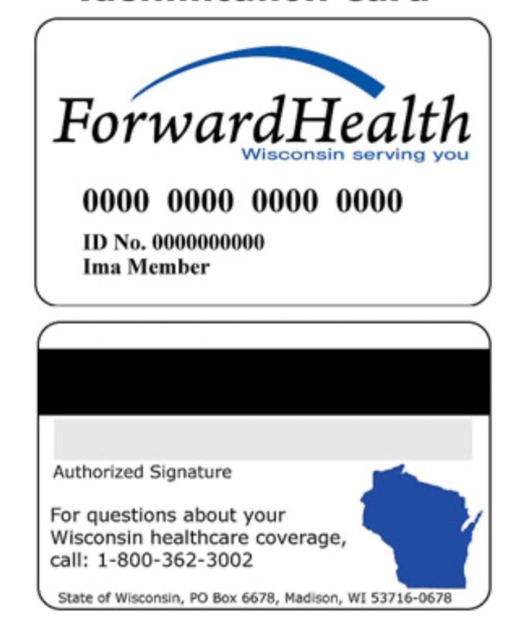
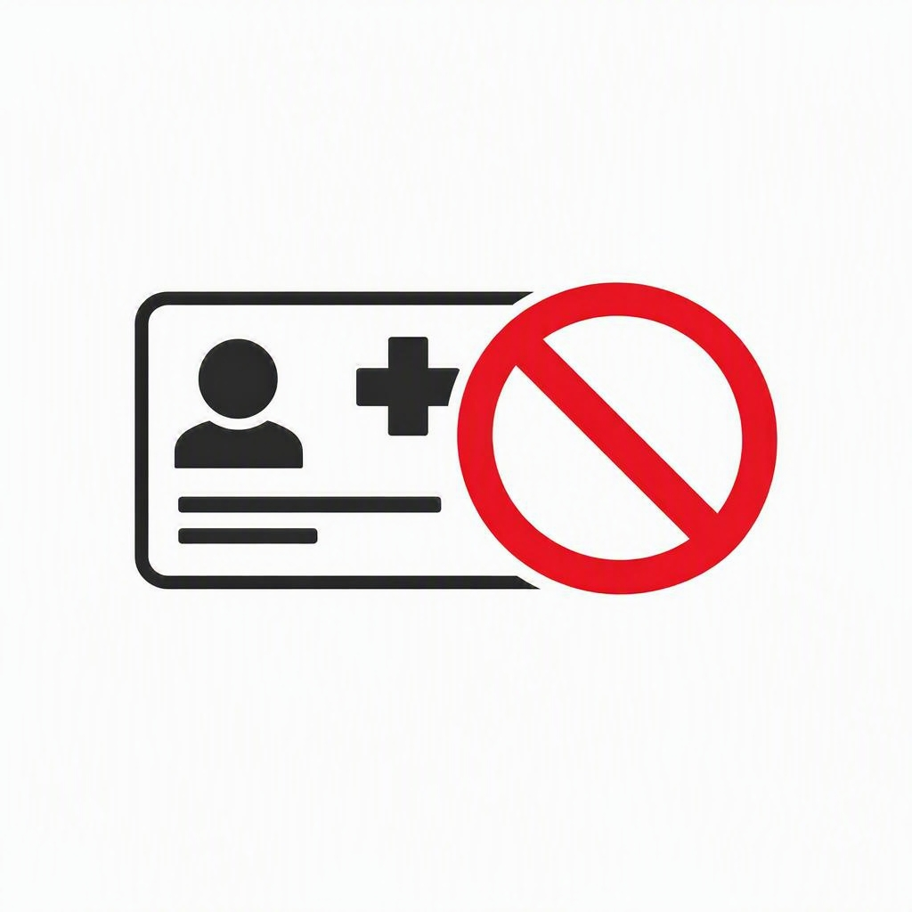
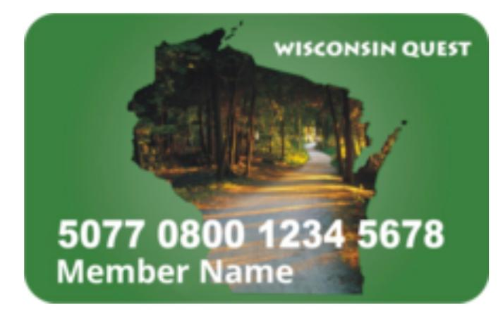
Medicaid and FoodShare Changes and Next Steps

Slide 2

Did you get a letter that says you may no longer be eligible to receive Medicaid or Food Share?
What do you need to know if these changes impact you and your family?

Slide 3
Medicaid Changes October 1, 2026.
On October 1st, 2026, refugees will not be eligible for Medicaid, unless they are legal permanent residents (LPR), pregnant, or children.
  In Wisconsin pregnant women and children will be allowed to stay on Medicaid. Non-LPR refugee women can keep access to Medicaid for up to one year after giving birth.

Slide 4



Remain on Medicaid
Refugees with LPR
Wisconsin
Children <19
Pregnant women

Slide 5
Medicaid Changes October 1, 2026.
Wisconsin
If you are not:
  pregnant
  child (under 19 years old)
  a legal permanent resident (green card holder)
  a legal citizen
  Then you will no longer be able to get Medicaid after October 1, 2026.

Slide 6
Medicaid Changes
Stay informed – watch your mail and make sure you understand messages you receive about changing benefits.
Communicate any changes about your immigration status right away to your income maintenance worker (IM).
https://www.dhs.wisconsin.gov/forwardhealth/partners/federal-changes.htm

Slide 7
If no action is taken, what does no Medicaid insurance mean?
It means that you will have to pay for all doctor visits.
You will have to pay for medications you are taking.
You will have to pay for lab testing.
You will have to pay for any testing you have done like x-rays and scans.
You will have to pay for it yourself using a credit card or cash.
You can still go to the emergency room but you most likely
will get a bill.
You will not be able to get home health or nursing home care.

Slide 8
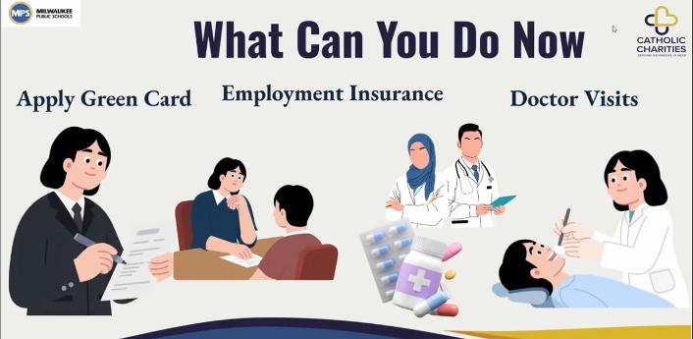

Slide 9

Medicaid – Loss of Insurance Next Steps
Apply for your Green Card- Legal permanent residency NOW!
Get all your vaccines
Apply for your green card (legal permanent residency status) as soon as possible!
Seeing a civil surgeon is part of the process
  Each civil surgeon has their own fee and requirements for I-693 forms
  Before meeting with a civil surgeon, it is best to get all required vaccines
Milwaukee specific civil surgeon locations:
    MCHC (803 W Layton Ave, Milwaukee, WI 53221/414-939-4411)
    Concentra Urgent Care (2455 N 124th St, Brookfield, WI 53005/262-782-9326)
    ProCare Medical Group (3727 W Wisconsin Ave, Milwaukee, WI 53208/414-291-2626)
    Med Point Family Care Center (5233 S 27th St Suite 1, Milwaukee, WI 53221/414-727-5850)

Slide 10

Vaccine Availability at Your Health Department?
Milwaukee Specific:
Southside Health Center
1639 S. 23rd Street
414-286-8620
Monday 3-6 PM, Tuesday 1-4 PM
Northwest Health Center
7630 W. Mill Rd
414-286-8830
Wednesday 3-6 PM
Keenan Health Center
3200 N. 36th Street
414-286-3631
Thursday 1-4 PM

Slide 11

Medicaid– Loss of Insurance Next Steps?
Can I get insurance at my job?
Establish an insurance plan if you expect to lose coverage.
  If your employer offers insurance, loss of Medicaid is considered a life event that would allow for enrollment in employer-based insurance outside of an open enrollment period.
  Contact Covering Wisconsin to discuss insurance and medication options.
    Call (608) 261-1455 or (877) 942-6837 to speak with a health insurance navigator.
    Make an appointment to sign up, change your plan, or ask questions. If you want to make an appointment online: https://coveringwi.org

Slide 12


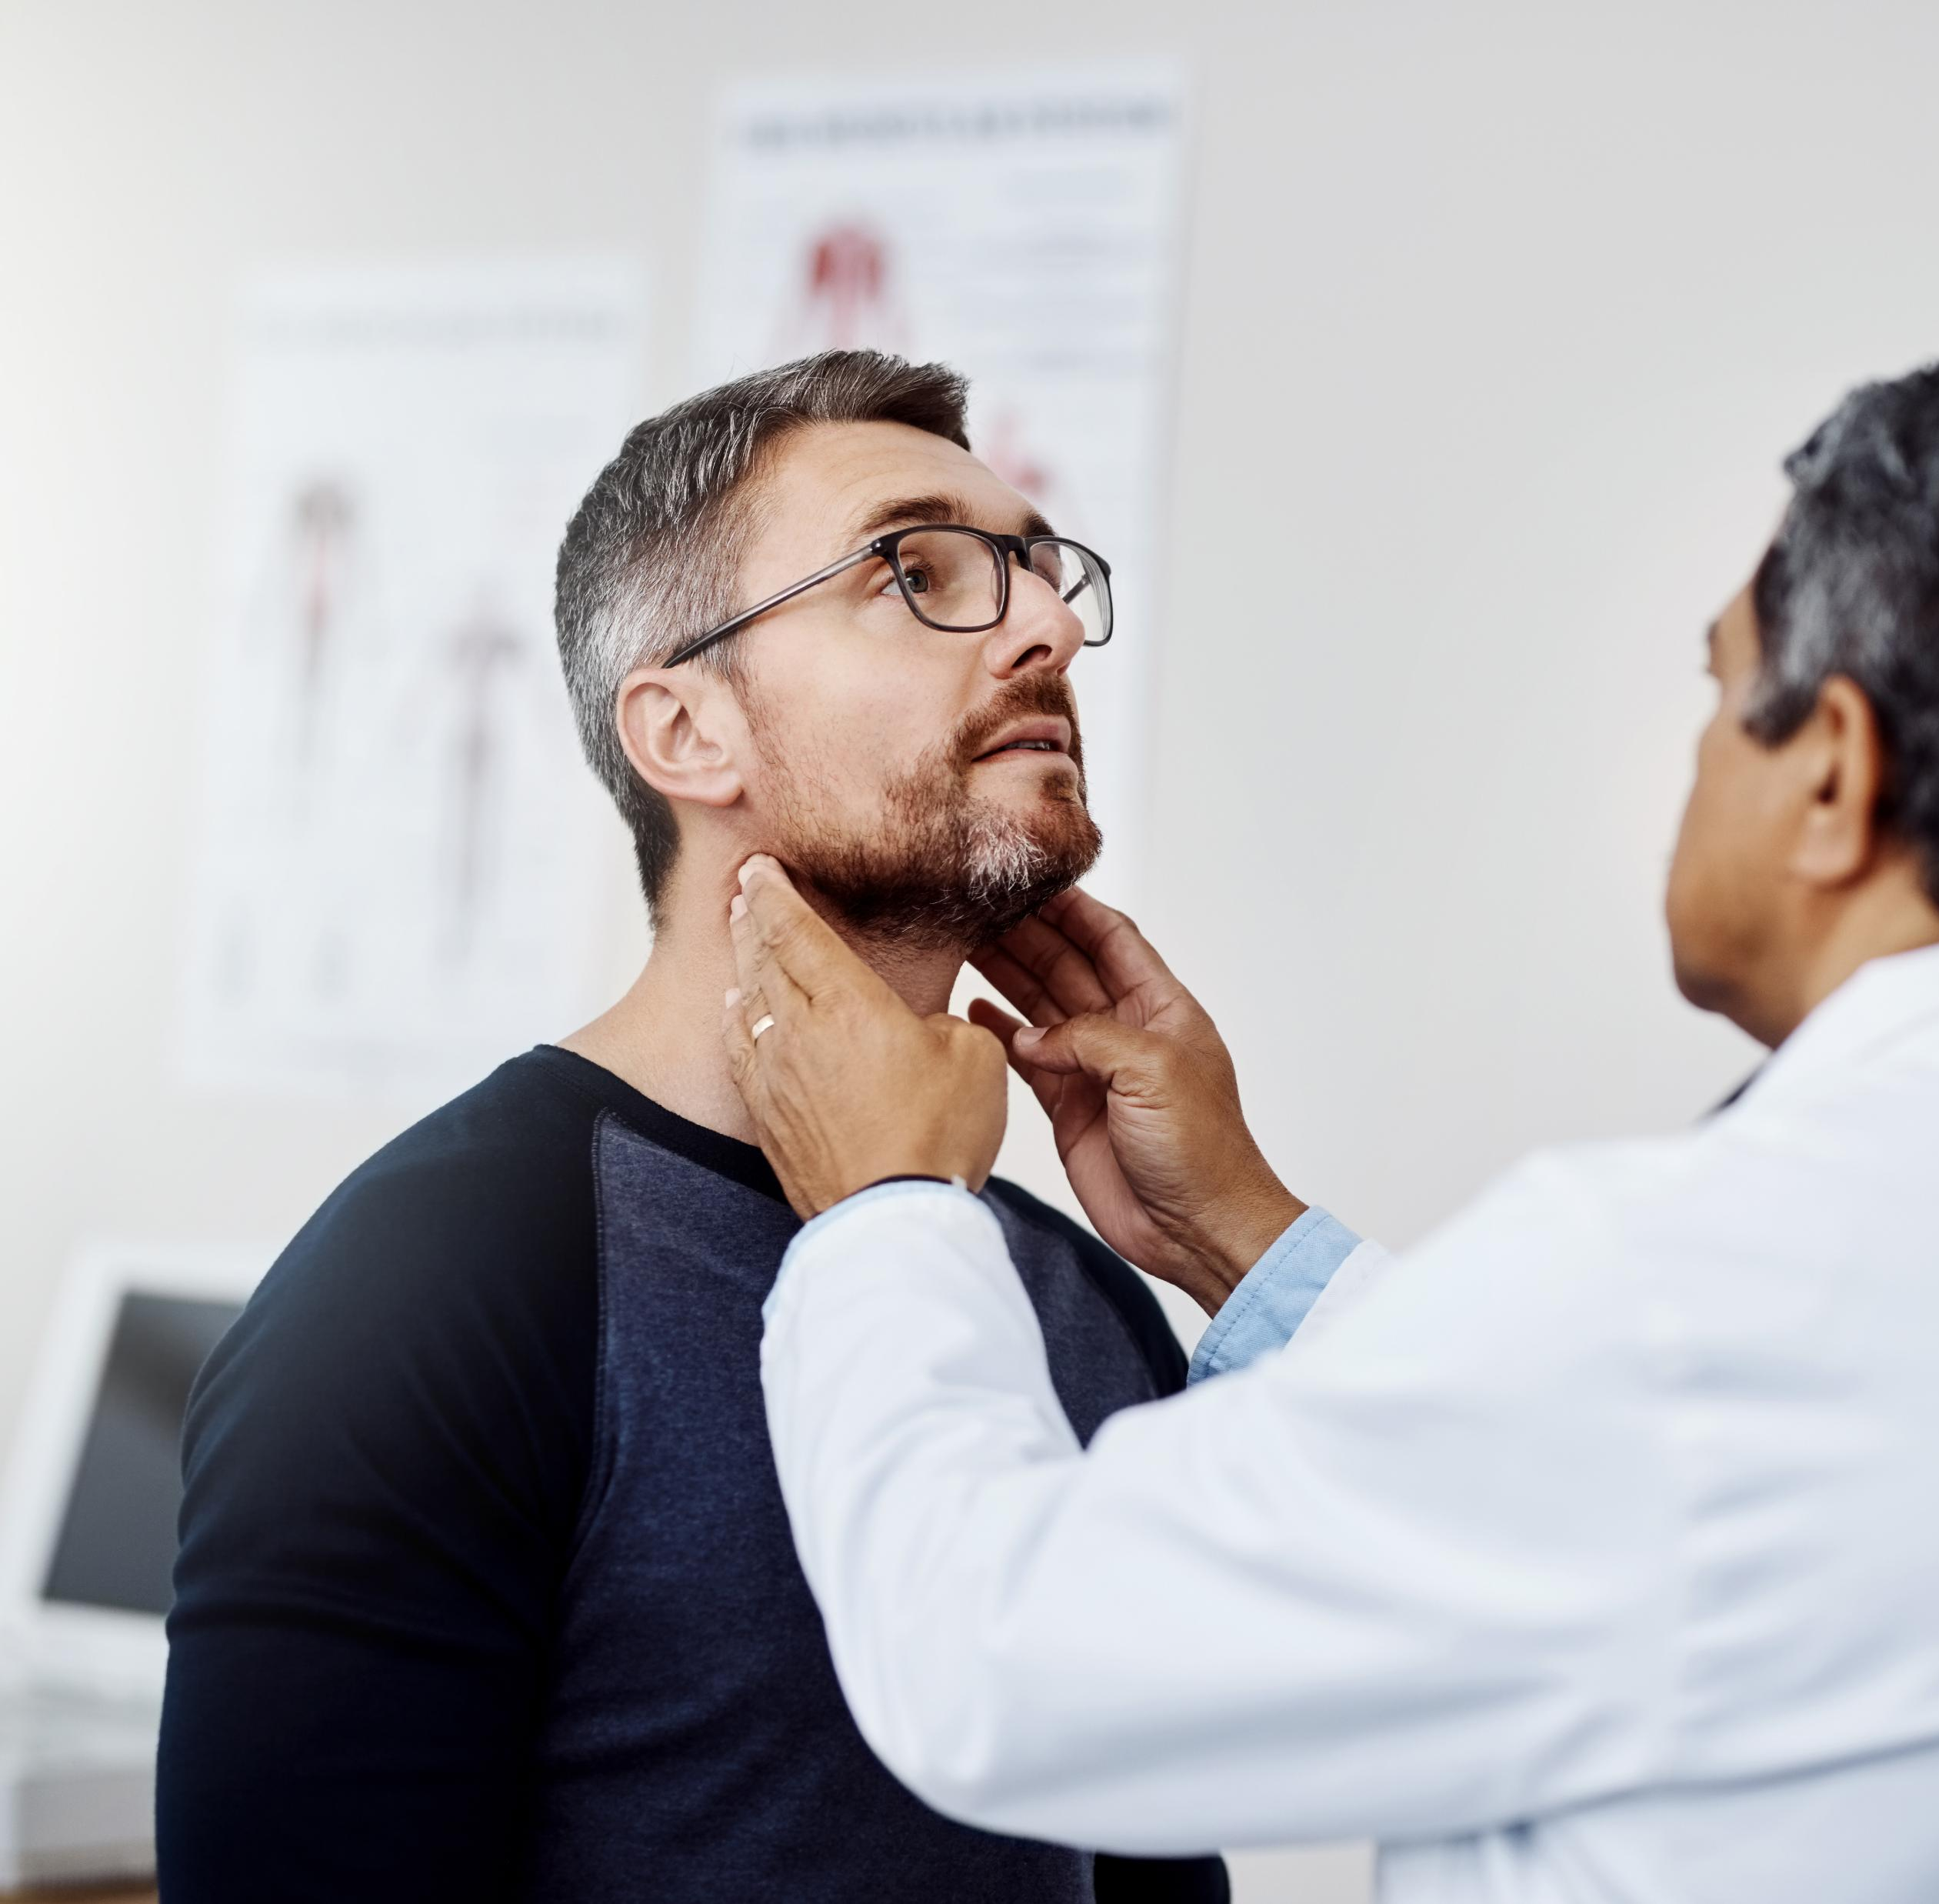

If I am losing MA 10/1/2026, what can I do?
Go to Medical Appointments
Go to Dentist
Get Medications
Make plans for healthcare after 10/1/2026

Slide 13
Medicaid – Loss of Insurance Next Steps
Elders
  Aging and Disability Resource Centers (ADRCs) | Wisconsin Department of Health Services
  ADRCs provide Wisconsin residents information related to aging or living with a disability. Their goal is to connect you with the right resources for your aging and disability needs.
  You can access ADRC services in several ways:
    Call or visit your local ADRC in person.
    Request a home visit from your local ADRC.
    Call 844-WIS-ADRC (844-947-2372) for help finding your local ADRC or Tribal ADRS.

Slide 14
If you are losing Medicaid, you have choices:
Find out if employer insurance is an option for you.
Try to keep going to the clinic you are attending. Tell your PCP about Medicaid.
Ask if your clinic offers Financial Assistance.
If your clinic does not offer financial assistance, then find a free or low-cost clinic.

Slide 15
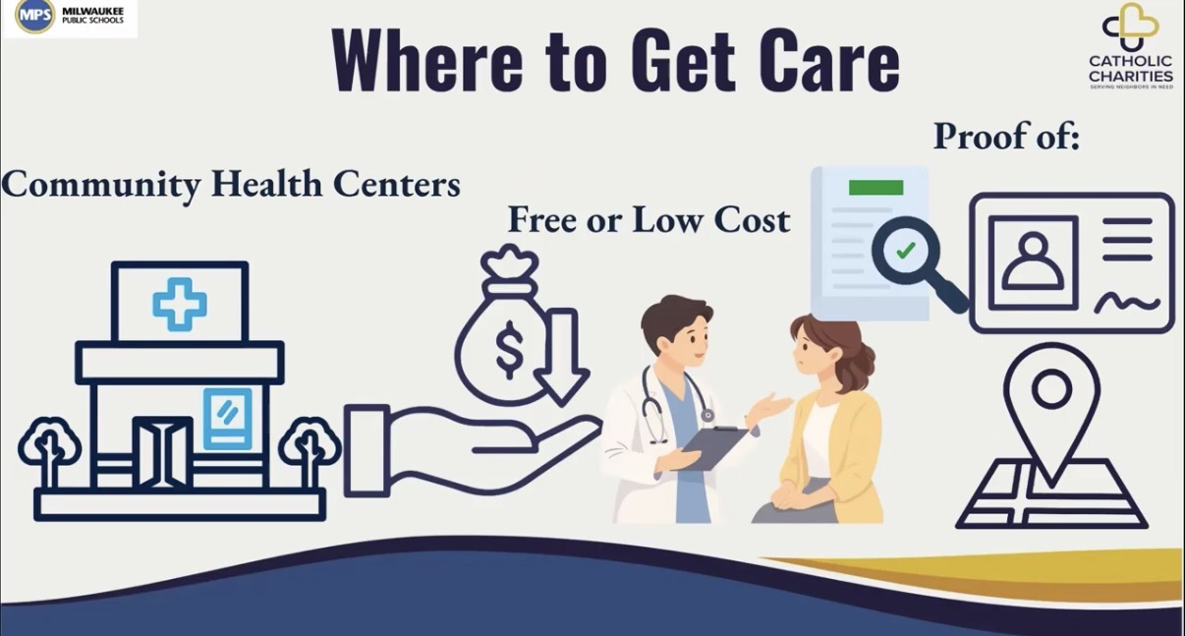

Slide 16




Medicaid – Loss of Insurance Next Steps
Work with your refugee resettlement agency and Covering WI to find local health care options
  Establish care at a Federally Qualified Health Center (FQHC) for quality care at lower costs.
    Find a Community Health Center - WPHCA | Wisconsin Primary Health Care Association
  Direct Primary Care Providers
  Free clinics
    Wisconsin Association of Free & Charitable Clinics

Slide 17






Milwaukee Community Clinics
Phone: 414-383-9526
930 W Historic Mitchell St, Milwaukee, WI 53204
We Speak Spanish
Phone: 414-977-0001
1821 N 16th St, Milwaukee, WI 53205
Phone: 414-672-1353
Chavez Clinic — 1032 S Cesar E Chavez Drive, Milwaukee, WI 53204
Parkway Clinic — 2806 S 20th St, Milwaukee, WI 53215
We Speak Spanish
Phone: 414-727-6320
210 W Capital Drive, Milwaukee, WI 53212
Phone: 414-647-7466
209 W Orchard St, Milwaukee, WI 53205
Phone: 414-372-8080
MLK Heritage Health Center — 2555 N Dr. MLK Jr Drive, Milwaukee, WI 53212
Phone: 414-760-3900
Isaac Coggs Heritage Health Center — 8200 W Silver Spring Drive, Milwaukee, WI 53218
Phone: 414-935-8000
3 Locations in North Side of Milwaukee
All these clinics accept patients with or without health insurance. The cost of care depends on your income — costs are fair and reasonable.

Slide 18
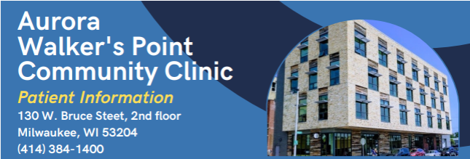
Milwaukee specific:
Aurora Walkers Point Community Clinic (AWPCC) – Free Clinic
Eligibility Process
    Live in Milwaukee County
    Have low income
    Do not have health insurance
    Cannot get health insurance
    Not getting care from another community clinic at this time.
      For people who have insurance options, AWPCC helps them connect to those options. You will be seen at AWPCC until then. If someone is uninsured and falls within their income guidelines, and is not established at another community clinic, they may be eligible to continue services at AWPCC.

Slide 19
Milwaukee specific:
AWPCC
Clinic hours:
    Monday-Friday 8:00 AM – 5:00 PM – Closed on Wednesdays from 12:00-1:15 PM
New Patient Registration:
    Monday through Thursday
    Arrive before 8:20 AM to register
    Same day or the next appointments available
Services:
    Primary and preventive care, mental health, counseling, and specialty care.
    Our team members speak multiple languages, and we work with interpreters to provide great care and communication in any language.
What is the cost?
Small donation requested with the costs of your care, but we will never turn you away if you are not able to contribute.

Slide 20
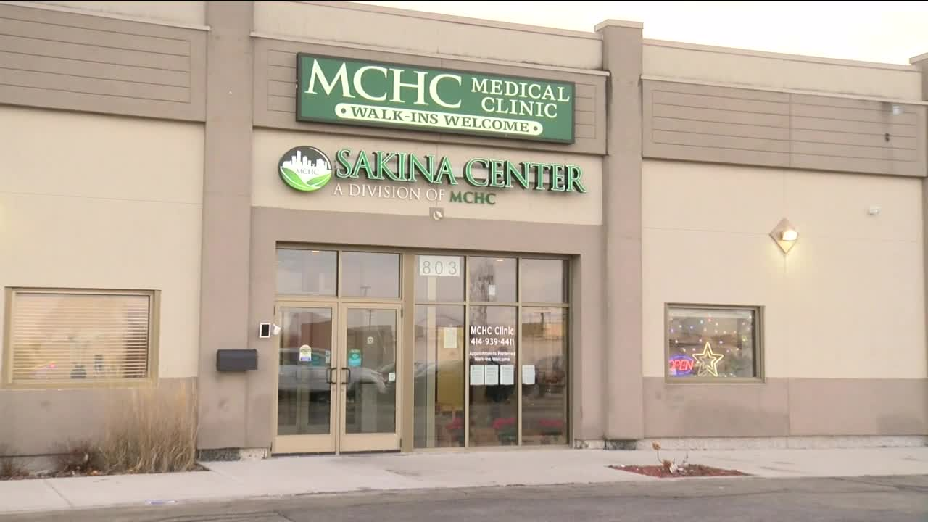
Milwaukee specific:
Muslim Community Health Center (MCHC) – FQHC Look Alike
Clinic Services
Vaccines for Children Program
    Vaccines free of cost to eligible patients
    Eligibility Criteria: Aged 0-18 AND:
      On Medicaid or Medicaid eligible OR
      uninsured
Vaccines for Adults Program - limited vaccines
    Eligibility criteria: Adults ages 19 and older that are either uninsured or underinsured
Access to specialty care for eligible low-income residents of Milwaukee county
Sakina Senior Center - senior activities

Slide 21
Milwaukee specific:
MCHC - FQHC Look Alike
Financial Assistance
  Financial Assistance for clinical services
    Sliding Fee Discount Program for individuals under 200% FPL Guidelines,
    Charity Care, and
    Payment Plans.
    Please note qualifying for financial assistance is based on eligibility requirements and supporting documentation of said eligibility criteria.
  Insurance eligibility assistance - MCHC has an insurance specialist who can help patients navigate registering for insurances
Food Assistance
  Sakina Senior Dining Site
  Hunger Task Force Mobile Market and Stock boxes
Sakina Senior Center - senior activities

Slide 22
More options for care…
Some non-LPR refugees can apply for Medicaid Emergency Services after 10/1/2026, if needed.
  Routine dialysis is covered for Wisconsin Medicaid Members assigned to Emergency MA and diagnosed with end-stage renal disease (ESRD). This will apply to non-pregnant, refugee adults who are not LPR.
  The emergency department should only be used for crisis situations because it is very expensive.
After October 1, 2026
For those with no insurance emergency care = $$$$

Slide 23
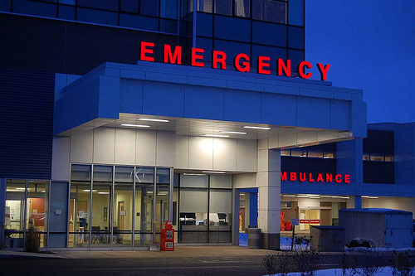
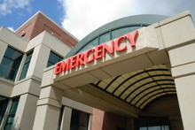
Only use emergency room for true emergencies as it will be expensive without Medicaid coverage.
This Photo by Unknown Author is licensed under CC BY-SA-NC

Slide 24
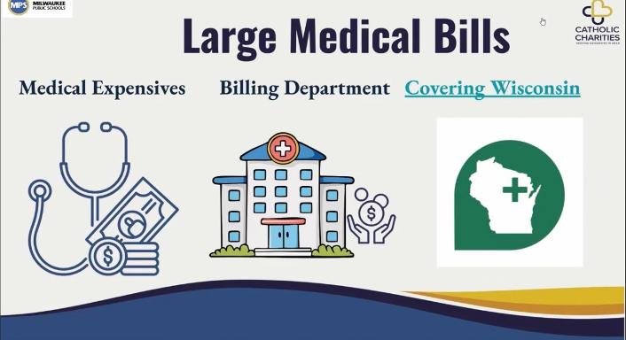
If you get a large bill, call and discuss it with the billing department
of your clinic or reach out to Covering Wisconsin

Slide 25

Video on Medicaid Changes
Catholic Charities of Milwaukee created videos about Medicaid changes in Wisconsin that may affect adult refugees without green cards, while children and pregnant women will stay covered. The links to specific languages the video is offered in are below.
Arabic
Burmese
Dari
English
Karen
Pashto
Rohingya
Somali
Spanish
Swahili
Ukrainian

Slide 26

Medicaid Loss - How to help pay for medications?
Tell your provider that you if you will not have health insurance and will have difficulty affording medications. Often, they will help find free or low-cost options for medications.

Slide 27
Medicaid Loss - How to help pay for medications?
Your health care provider can put you in touch with programs that can help you.
Here is one link that can put you find more affordable medications:
https://www.needymeds.org/search-programs?initialSearchTab=drugs

Slide 28

FoodShare – What is changing?
Refugees in WI without a green card will not be eligible for FoodShare (SNAP) beginning in the Summer 2026.
  Changes are happening. Officially the policy changed for new applicants on July 1st, 2026, but clients may have started seeing changes as early as June 2026. Those who have not yet renewed their applications will see the change at the time of renewal. Those with both MA and FoodShare will experience the change as of October 1, 2026, if they have not already seen a change in their FoodShare benefit.

Slide 29
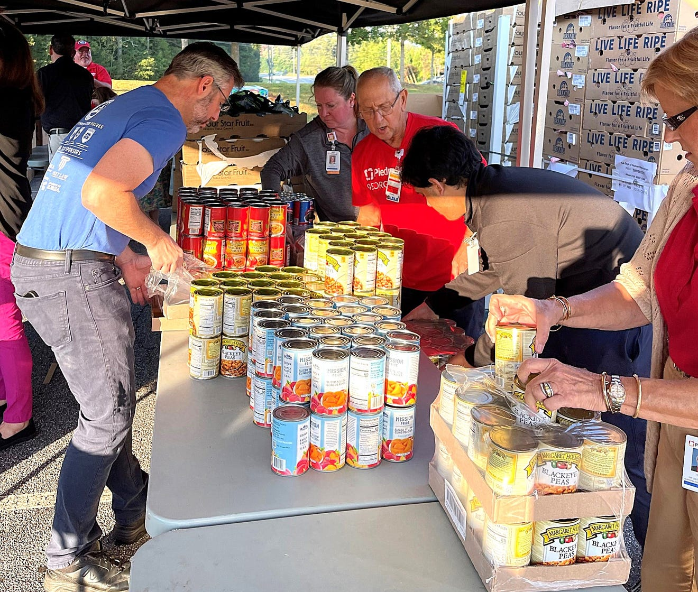
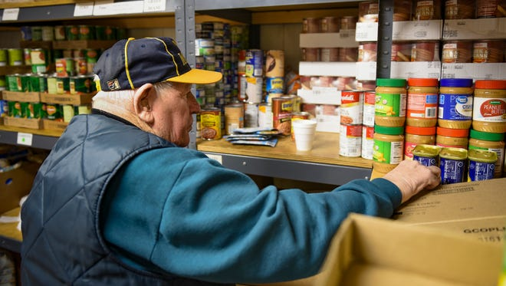
FoodShare loss of benefits: State Web Pages
These pages have the most current information the Wisconsin Department of Health Services (DHS)/Department of Medicaid Services (DMS):
  WI DHS Webinar on Medicaid and FoodShare Changes
  Medicaid and FoodShare Partner Resources: Federal Changes
  FoodShare: News for Members | Wisconsin Department of Health Services
  FoodShare: A Recipe for Good Health | Wisconsin Department of Health Services

Slide 30

FoodShare – loss
What to do?
Find your local food pantry.
Ask your local resettlement agency if they have a volunteer food delivery system.
WIC supplies (e.g., baby formula) that have been returned are donated to food pantries.

Slide 31
Milwaukee specific:
Food Resources in the Milwaukee Area
Ebenezer Stone Ministries/Food Pantry 1127 S 35th St, Milwaukee, WI 53215 414-383-0710
Reiske Park Farmers Market - S. 24th Street Affordable farmers market - Tuesdays, 3-6:30pm
NourishMKE is a community food resource.
  Fond du Lac Food Center 10230 W. Fond Du Lac Avenue, 53224
  Mitchell Food Center 1615 S. 22nd Street, Milwaukee, WI 53204
  Orchard Food Center
  209 W. Orchard Street, Milwaukee, WI 53204
  Cherry Food Center
  1230 W. Cherry Street, Milwaukee, WI 53205
COA Youth and Family Centers – 2320 W. W. Burleigh St.: Food Pantry and Diaper bank serves the 53206-zip code
Resources & Beyond - N. 76th Street
Somali Resource Center 1020 W. Historical Michelle St. Basement STE #3
Offers Halal food boxes and occasionally halal meat
Kinship Community Food Center St. Casmir’s Church 924 E Clarke St., W. Clarke St. Has some zip code restrictions
Milwaukee Community Crossroads -807 S. 14th Street (Back of parking lot) call (414) 902-5391
People’s Table – 1414 W Becher St.
Hanan - 3927 S Howell Avenue,
Milwaukee, WI 53207

Slide 32

Milwaukee specific:
Hunger Task Force
Hunger Task Force is the food bank that covers the Milwaukee area.
  If you are in the Milwaukee area, you should go directly to your resettlement agency. Do NOT go directly to Hunger Task Force. The agency will send your information to Hunger Task Force.

Slide 33

Video on Accessing Your Local Food Pantry
Catholic Charities of Milwaukee created videos that explain how families can access free groceries through local food pantries, what to expect during a visit, what to bring, and information about halal food options in Milwaukee. The links to specific languages the video is offered in are below.
Arabic
Burmese
Dari
English
Karen
Pashto
Rohingya
Somali
Spanish
Swahili
Ukrainian

Slide 34


Still available:
Free Breakfast and Lunch at Public School
“Healthy Meals, Healthy Kids” Public schools will continue to provide free meals to enrolled children
Milwaukee Public School
All students in MPS district receive free breakfast and lunch though the Community Eligibility Provision.

